Slide 1
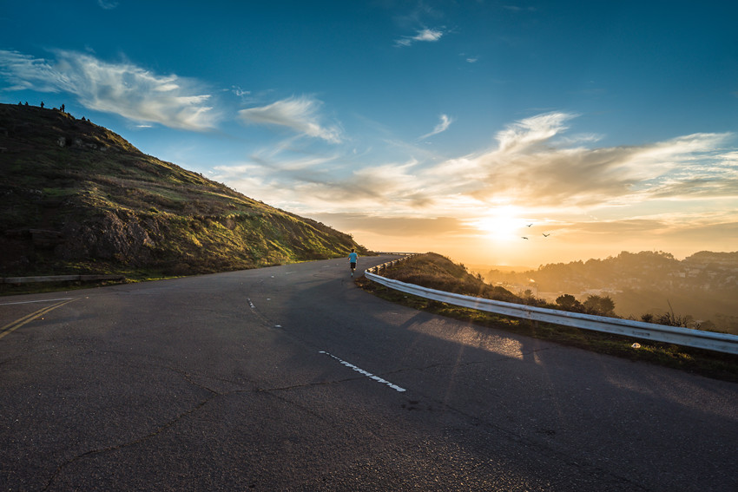
Progress Report
Group 4
2022
Group Members:
YUKI,TAKERU
PETE,BRUCE,ERIC,PONNIE,SHIN

Slide 2
01.Hardware
CONCENTS
02.Software

Slide 3
01
Hardware Progress

Slide 4
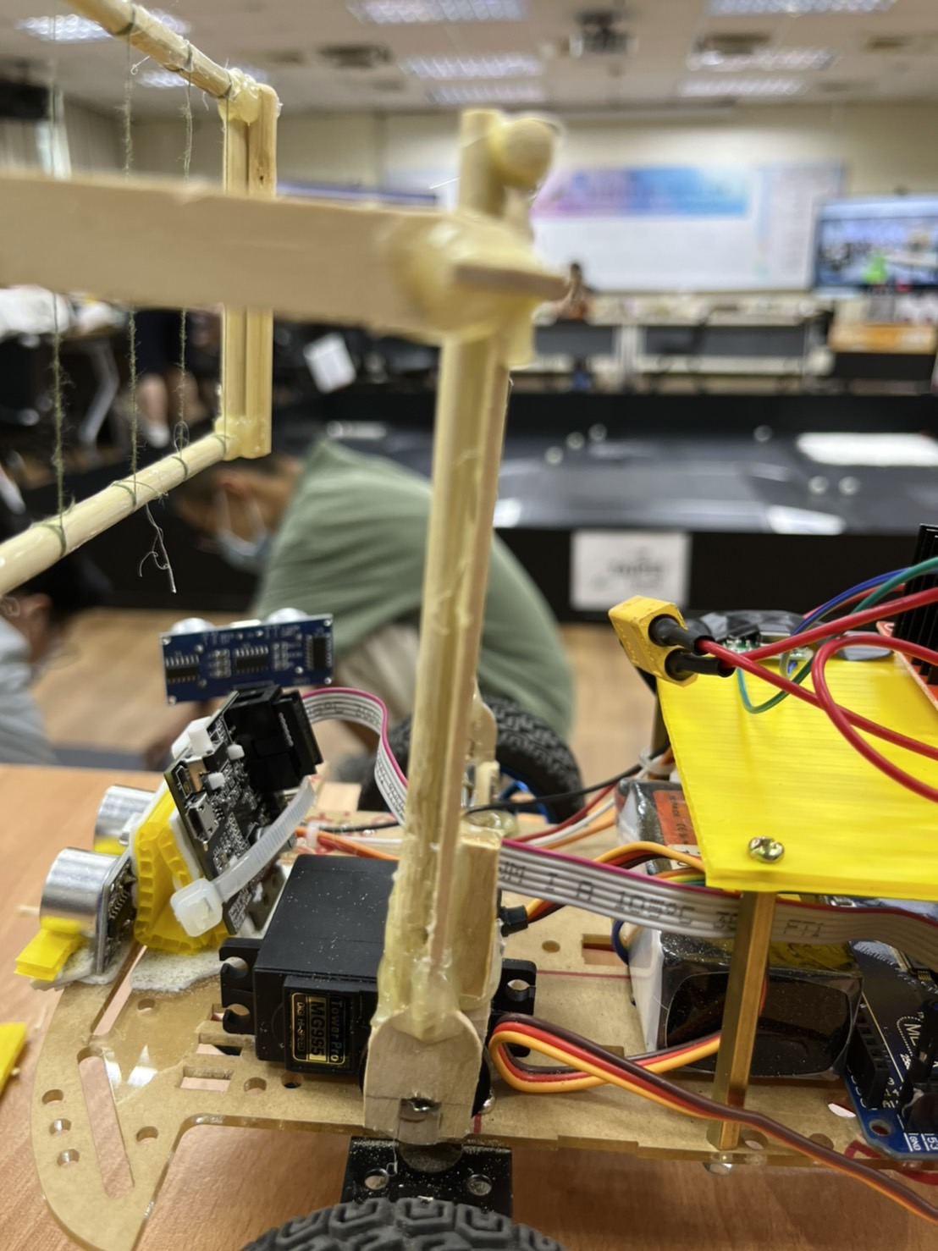
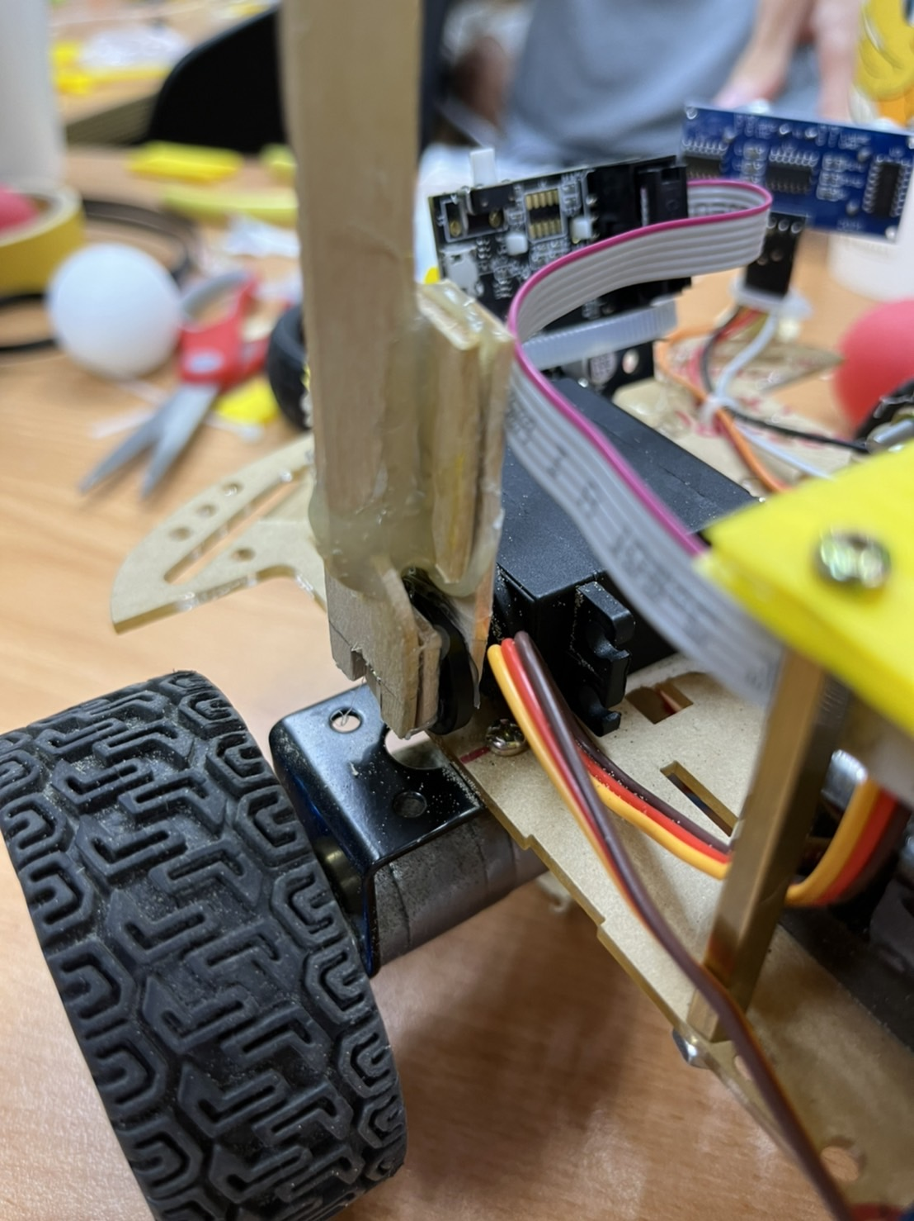
Strength the ball-catching mechanism

Slide 5
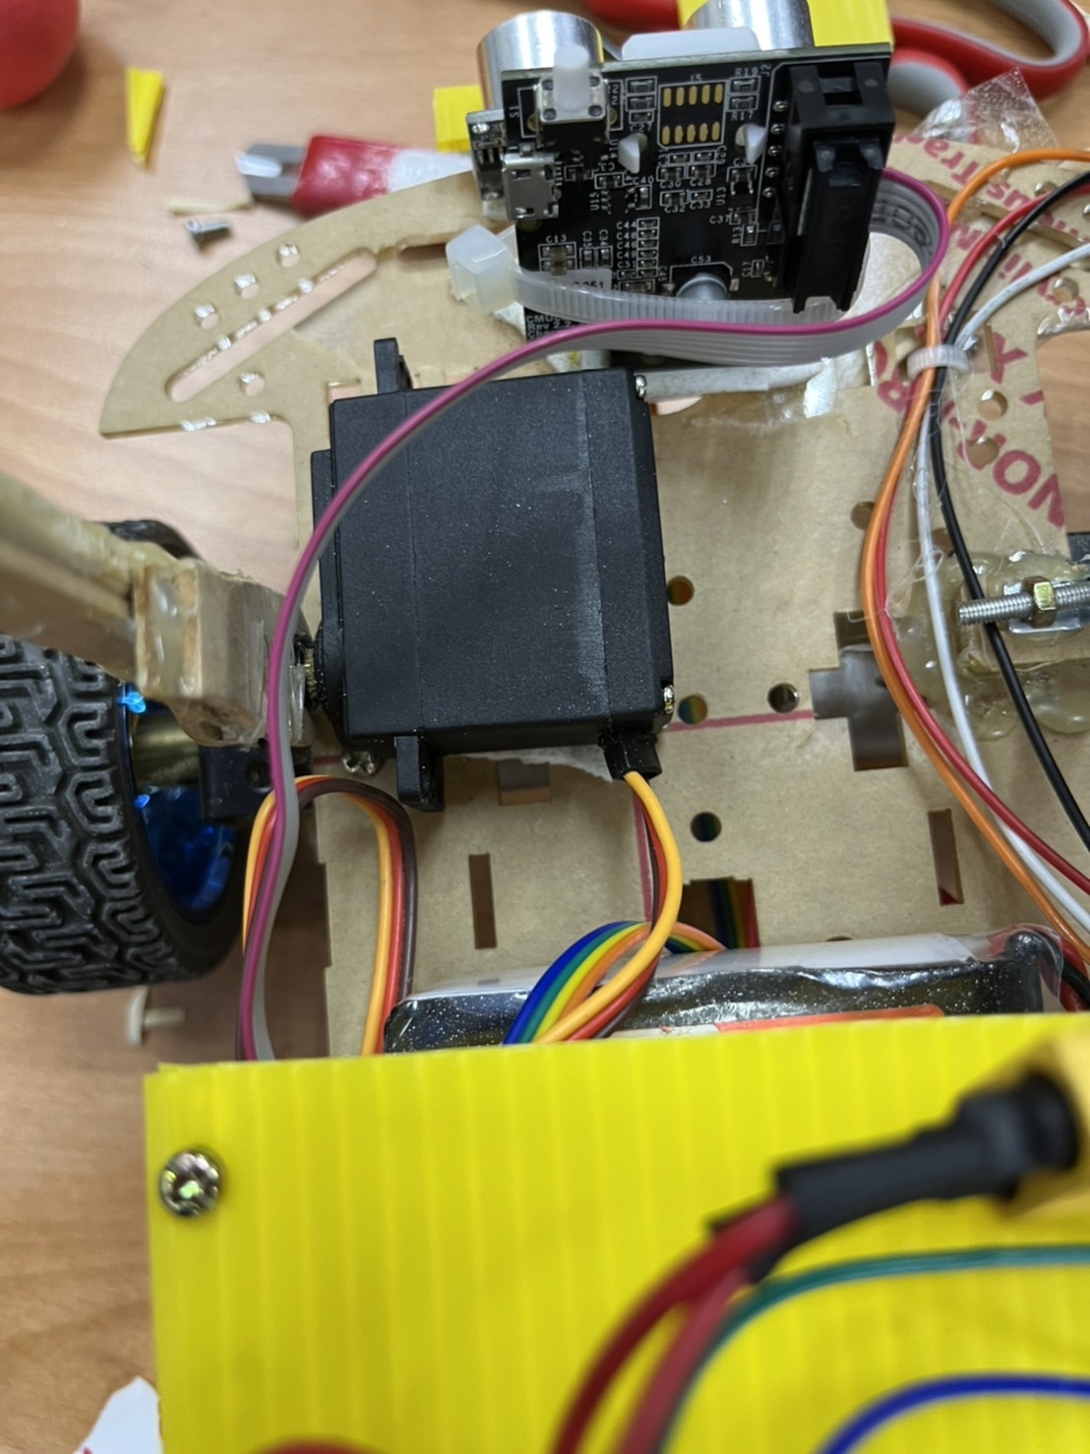
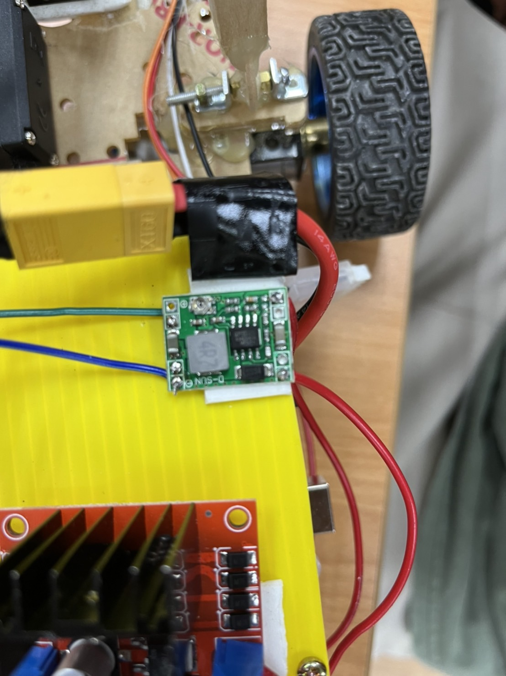
Upgrade the servo motor

Slide 6
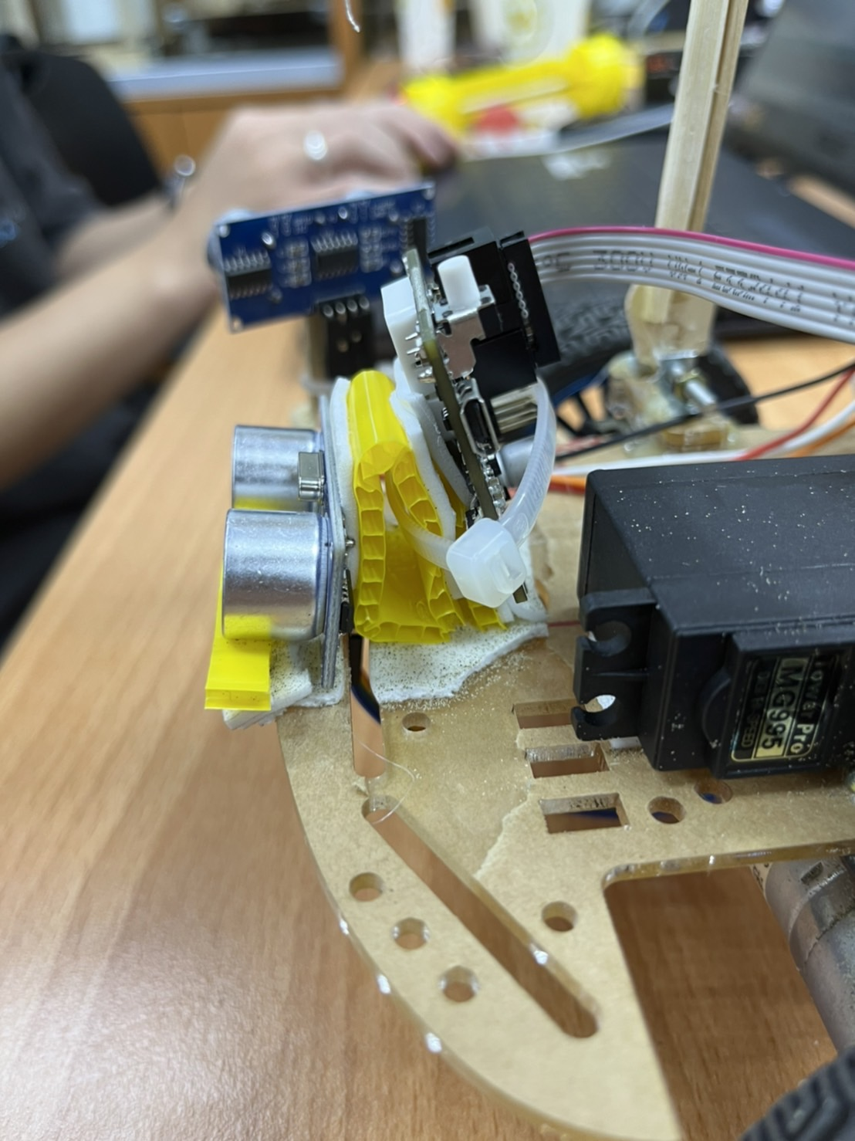
Adjust the position of the sensor

Slide 7
02
Software Progress

Slide 8
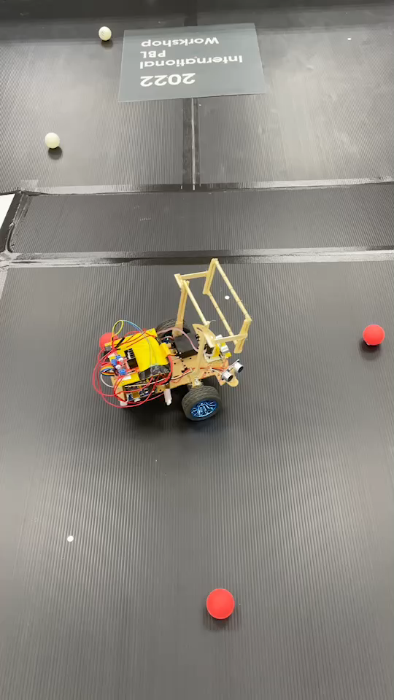
Some variables adjustment

Slide 9
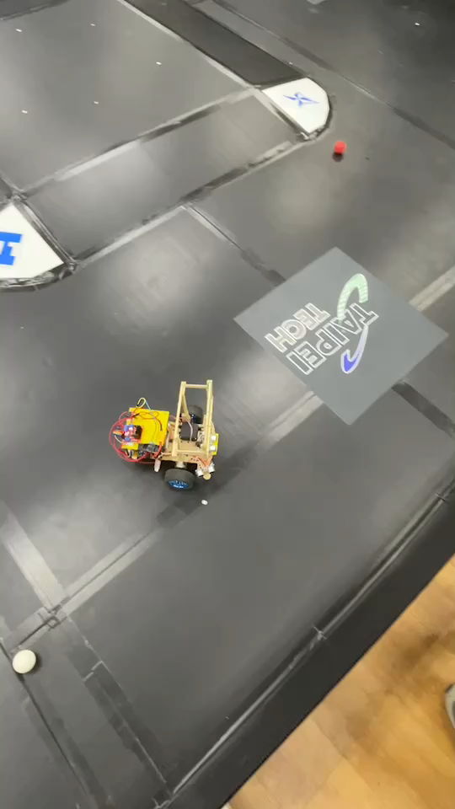
Some variables adjustment

Slide 10
What we are going to do next:
1.Basket to store the balls
2.A “ball stop” in front of the car
3.Improvement of the sonic sensor detection
4.More try and error

Slide 11
THANK YOU

